Slide 1


ARJUN COLLEGE OF TECHNOLOGY
Thamaraikulam , Coimbatore-Pollachi Highway,Coimbatore-642 120 Approved by AICTE , New Delhi &Affiliated to Anna university, Chennai
An Iso 9001:2015 Certified Institution
Lung Sense Pro: Predictive Modelling for Lung Cancer Analysis using Machine Learning
PRESENTED BY
BATHALA PRAVEEN | (723920104009)
CHUNCHU MANOJ | (723920104015)
SASIDEVAN P | (723920104049)
GUIDED BY
Ms.R.LATHA PRIYADHARSHINI M.E,
ASSISTANT PROFESSOR/CSE

Slide 2
AGENDA
Objective
Introduction
Literature Survey
Existing System
Limitations
Modules
Proposed System
System Specification
Implementation
Advantages
Conclusion
References

Slide 3
OBJECTIVE
The main objective of this project is to forecast the existence of lung cancer using medical records and interpreting CT images, employing advanced machine learning and deep learning techniques.
This project seeks to enhance early detection rates and improve patient outcomes through timely intervention and personalized healthcare approaches.

Slide 4
INTRODUCTION
MACHINE LEARNING
Pattern Recognition: Identify patterns in data (e.g., images, speech).
Predictive Analytics: Forecast future trends based on historical data.
Classification/Regression: Categorize data or predict outcomes (e.g., spam detection, price forecasting).
Automated Decision Making: Integrate ML into processes for efficient decision-making (e.g., fraud detection).
Natural Language Processing: Understand and generate human language (e.g., virtual assistants).

Slide 5
DEEP LEARNING
Hierarchical Representations: Learns complex features through multiple layers.
Data Handling: Processes large volumes efficiently.
Feature Extraction: Automatically extracts relevant features.
Non-linear Relationships: Captures intricate patterns in data.
Adaptability: Improves with exposure to more data.
Broad Applications: Used in various domains like computer vision, speech recognition, and healthcare.

Slide 6
CONVOLUTIONAL NEURAL NETWORK
Image Classification: Identify objects or scenes in images.
Object Detection: Locate and classify multiple objects.
Semantic Segmentation: Label each pixel in an image.
Feature Extraction: Learn abstract patterns from data.
Image Generation: Create realistic images from noise.
Image Captioning: Generate descriptions for images.
Transfer Learning: Adapt pre-trained models for new tasks.

Slide 7
LITERATURE SURVEY
YEAR | AUTHOR | TITLE | METHOD | MISSED OUT AREA
2021 | Muthazhagan B, Ravi T, Rajinigirinath D | An enhanced computer-assisted lung cancer detection method using content-based image retrieval and data mining techniques [1] | Support Vector Machine image Classification algorithm | The malignancy is classified as ‘Normal’ and ‘Abnormal’, not as Stages 1-4
2021 | Masud M, Sikder N, et al. | A Machine Learning Approach to Diagnosing Lung and Colon Cancer Using a Deep Learning-Based Classification Framework [2] | 3 Digital Image Processing techniques with CNN | Dataset uses microscopic cells images rather than CT/MRI scans

Slide 8
LITERATURE SURVEY Contd.,
YEAR | AUTHOR | TITLE | METHOD | MISSED OUT AREA
2019 | Sajja T, Devarapalli R, Kalluri H | Lung Cancer Detection Based on CT Scan Images by Using Deep Transfer Learning | A deep neural network based on Google-Net | Overfitted data causing the need for max dropout ratio
2019 | Tripathi P, Tyagi S, Nath M | Comparative Analysis of Segmentation Techniques for Lung Cancer Detection | comparative analysis- image segmentation techniques | marker-controlled watershed segmentation provides more accurate results.
2019 | Nasrullah N, Sang J, Alam MS, Mateen M, Cai B, Hu H | Automated Lung Nodule Detection and Classification Using Deep Learning Combined with Multiple Strategies | Two 3D CNN with CMixNet architectures | 3D CMixNet had better accuracy feature exploitation than other models compared with.

Slide 9
LITERATURE SURVEY Contd.,
YEAR | AUTHOR | TITLE | METHOD | MISSED OUT AREA
2019 | Bhatia S, Sinha Y, Goel L | Lung Cancer Detection: A Deep Learning Approach | deep residual networks with XGBoost and Random Forest classifiers and ensemble | The highest accuracy was 84% using an ensemble of both models tried which still a comparatively low accuracy
2018 | Makaju S, Prasad PW, et al. | Lung Cancer Detection using CT Scan Images | Watershed algorithm with SVM | Classification of different stages of cancer is not done
2018 | Ali I, Hart GR, et al. - | Lung Nodule Detection via Deep Reinforcement Learning | Reinforcement learning algorithm | The model is overfit as training accuracy obtained was 99.1% whereas the testing accuracy was 64.4%

Slide 10
EXISTING SYSTEM
Analyzing lung nodules helps determine if cancer is present, but some nodules can grow unnoticed by naked eye.
There are many reasons behind cancer, ranging from behavioral traits such as high body mass index, tobacco and alcohol usage to physical carcinogens.
Such as exposure to ultraviolet rays and radiation, including certain biological and genetic carcinogens.
Common cancer symptoms include pain, fatigue, nausea, persistent cough, breathing difficulties, weight loss, muscle pain, bleeding, bruising, and various additional indicators.

Slide 11
EXISTING SYSTEM Contd.,
Symptoms aren't exclusive to cancer and may vary between patients.
Diagnosis requires thorough procedures such as CT scans, MRI, PET scans, ultrasound, or biopsy.
Early stages may show minimal symptoms, with late-stage symptoms often indicating advanced cancer.
Lung cancer comprises small cell lung cancer (SCLC) and non-small cell lung cancer (NSCLC).
The detection of lung cancer relies on analyzing previous patient records and utilizing CT scans for prediction and identification of lung nodules.

Slide 12
EXISTING SYSTEM Contd.,
Early detection is crucial for effective treatment and improving patient outcomes.
Various risk factors such as smoking, environmental exposures, and genetic predispositions contribute to the development of lung cancer.
Multidisciplinary approaches involving oncologists, radiologists, pathologists, and other specialists are essential for accurate diagnosis and treatment planning.

Slide 13
BLOCK DIAGRAM
Data Collection
Preprocessing
Feature Extraction
Machine Learning Model
Result Interpretation
Real-time Inference
Deployment & Integration
Model Training & Evaluation

Slide 14
LIMITATIONS
Some nodules can grow unnoticed by the naked eye, so detecting lung cancer in the early stage is difficult.
The system lacks diverse detection methods, relying only on past medical data for lung cancer identification.
Prediction accuracy is compromised due to reliance solely on symptoms for diagnosis.
There's no provision for estimating medical insurance costs, limiting comprehensive support.
User interaction is limited, hindering effective data analysis and interpretation.

Slide 15
MODULES
Lung Cancer Detection based on Symptoms
Lung Cancer Classification using CT Scans
Medical Insurance Cost Prediction
Data Analysis using Plotly
Web Application Development

Slide 16
PROPOSED SYSTEM
The primary goal of this project is to examine prior medical information in order to detect lung cancer, predict if the patient has lung cancer using the CT scans and then predict the stage of lung cancer by nodule detection.
Additional aid is provided by anticipating medical insurance expenditures.
Lung Cancer Detection based on symptoms: The Random Forest Classifier is trained with a dataset containing previous patients’ symptoms records and is used to classify if the patient has lung cancer or not.

Slide 17
PROPOSED SYSTEM Contd.,
The primary goal of this project is to examine prior medical information in order to detect lung cancer, predict if the patient has lung cancer using the CT scans and then predict the stage of lung cancer by nodule detection.
Additional aid is provided by anticipating medical insurance expenditures.
Lung Cancer Detection based on symptoms: The Random Forest Classifier is trained with a dataset containing previous patients’ symptoms records and is used to classify if the patient has lung cancer or not.

Slide 18
PROPOSED SYSTEM Contd.,
Develop a Web Application: A web application is created for better user interaction, which includes all the above stages. The application helps in real-time lung cancer diagnosis and medical insurance cost estimation.
The proposed project is a web application with the main web page comprising three buttons.
The first button directs the user to the lung cancer detection based on symptoms, the second button to the lung cancer classification based on CT scans page
Finally, the third button directs the user to the medical insurance cost prediction.

Slide 19
RANDOM FOREST IN LUNG CANCER DETECTION
Introduction to Random Forest Algorithm (RFA)
Definition: The Random Forest algorithm constructs an ensemble of decision trees to enhance prediction accuracy.
Application: It serves as the foundation for both the Random Forest Classifier and Regressor in our project.
Random Forest Classifier (RFC) for Lung Cancer Detection
The Random Forest Classifier analyzes symptoms to predict the presence of lung cancer.
It combines the predictions of multiple decision trees based on symptom data.

Slide 20
RANDOM FOREST IN LUNG CANCER DETECTION Contd.,
To classify whether a patient has lung cancer, providing early detection and intervention.
Random Forest Regressor (RFR) for Insurance Cost Prediction
The Random Forest Regressor estimates medical insurance costs for patients with lung cancer.
It utilizes the Random Forest algorithm to predict insurance expenses.
To aid in financial planning for patients and healthcare providers, facilitating informed decision-making.

Slide 21
SYSTEM SPECIFICATION
HARDWARE REQUIREMENTS
Processor : I3 processor GHz
RAM : 4 GB
Hard Disk : 450 GB
Mouse : Logitech Mouse
Keyboard : Logitech Keyboard

Slide 22
SYSTEM SPECIFICATION Contd.,
SOFTWARE REQUIREMENTS
Operating System : Windows 10
Ram : 8GB
Programming language : PHP,HTML,CSS,PYTHON
Libraries & Frameworks : TensorFlow, PyTorch, Keras, NumPy,
Pandas, Matplotlib and Seaborn, Scikit-learn
Development Environment: Visual Studio Code,

Slide 23
IMPLEMENTATION
Lung Cancer Detection based on symptoms
Lung Cancer Analysis using Plotly
Lung Cancer Detection
NO
Dashboard containing Plotly graphs
User Input form
Output
Healthy
YES
Lung Cancer Classification using CT Scans

Slide 24
PROPOSED WORKFLOW Contd.,
Lung Cancer Classification using CT Scans
Normal
User Input Image for Lung Cancer Classification
Output
Benign
Malignant
Medical Insurance Cost Prediction

Slide 25
PROPOSED WORKFLOW Contd.,
Medical Insurance Cost Prediction
Medical Insurance Analysis using Plotly
Medical Insurance Prediction
Output
Dashboard Containing Plotly graphs
User Input form
Medical Insurance cost

Slide 26
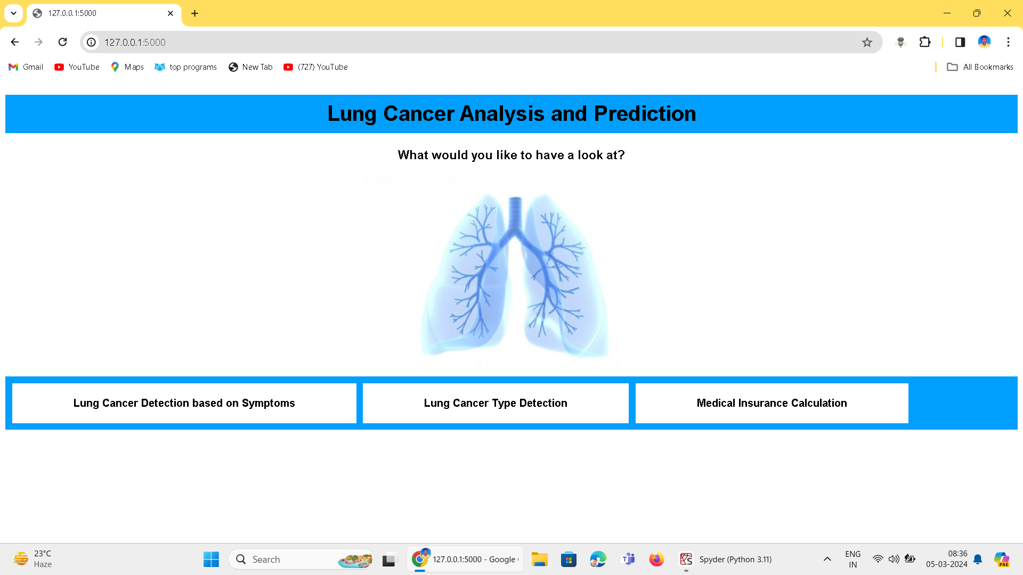
Home Page

Slide 27
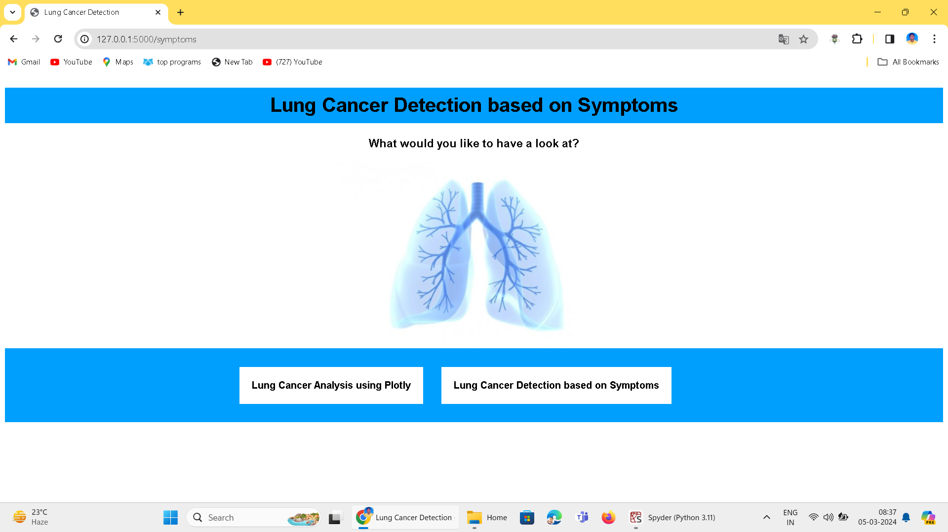
Lung Cancer Detection based on Symptoms

Slide 28
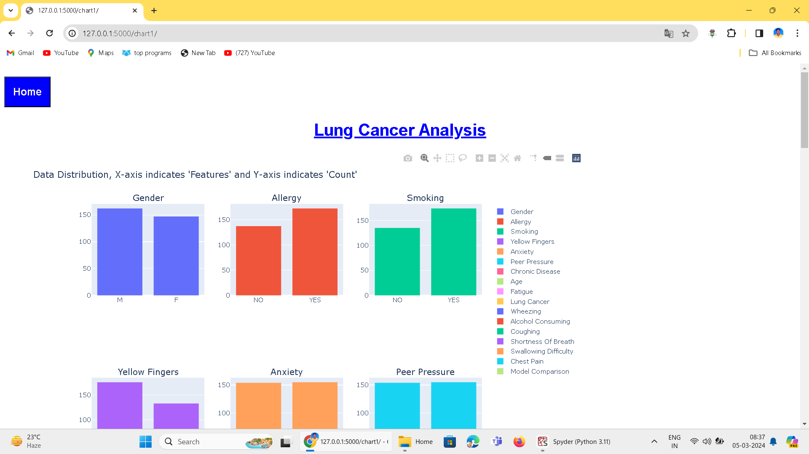
Lung Cancer Analysis using Plotly

Slide 29
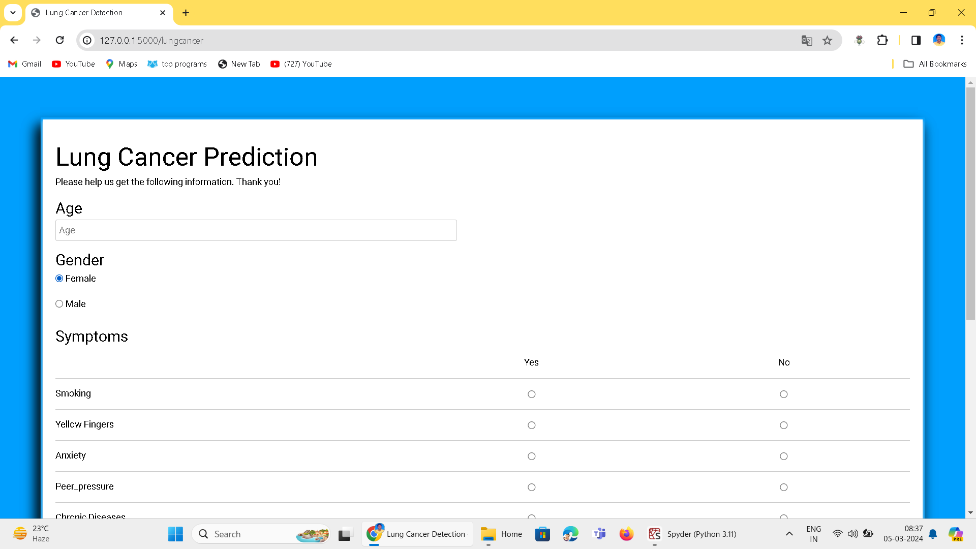
Lung Cancer Based on Symptoms

Slide 30
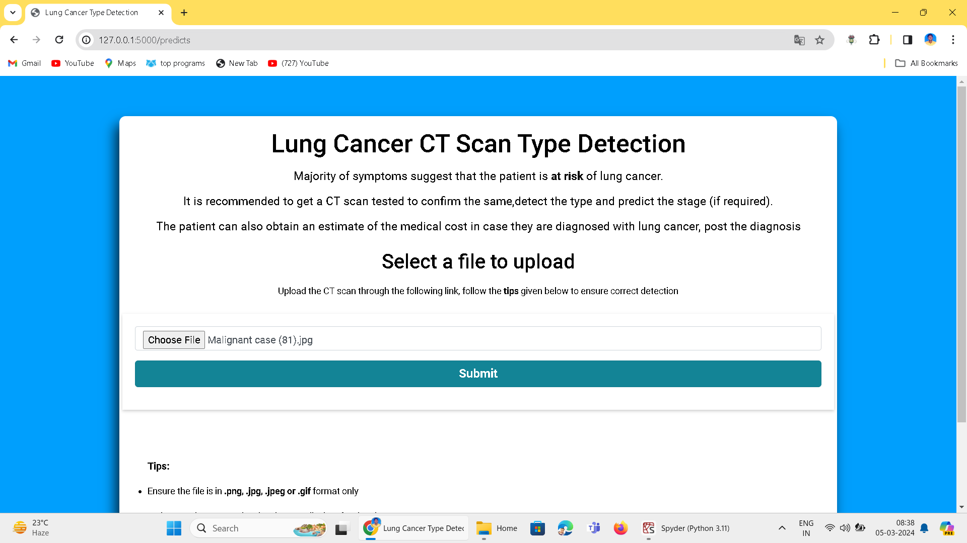
Type Detection: Uploading(Benign Case)

Slide 31
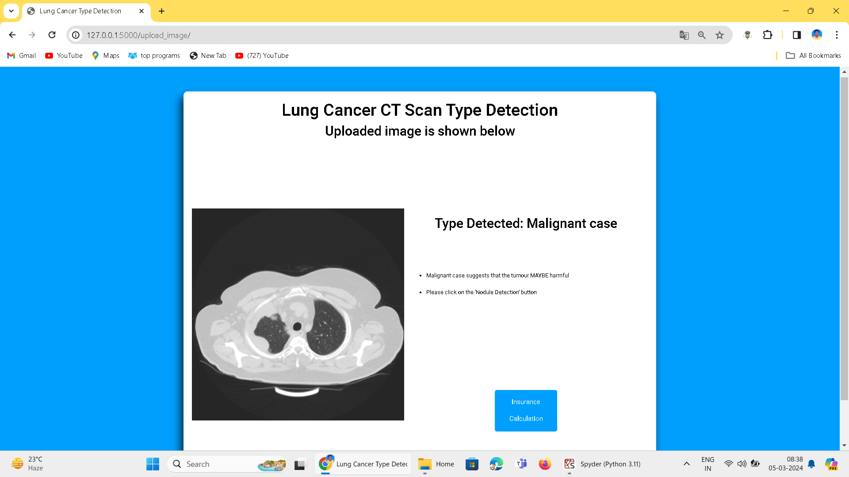
Type Detection Output

Slide 32
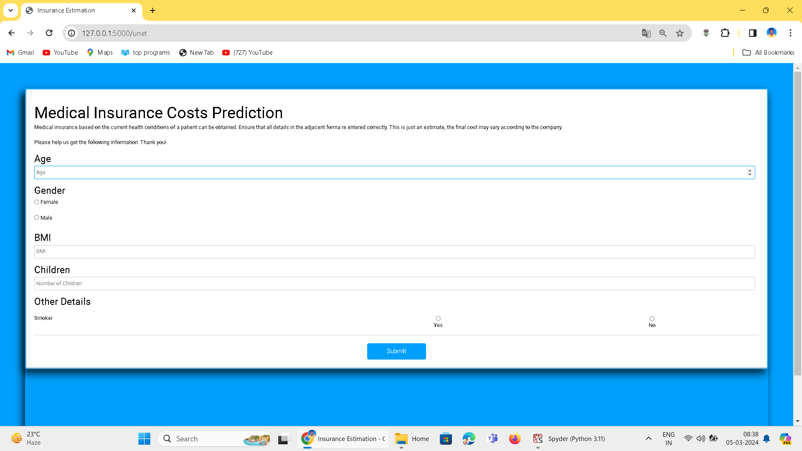
Medical Insurance Prediction

Slide 33
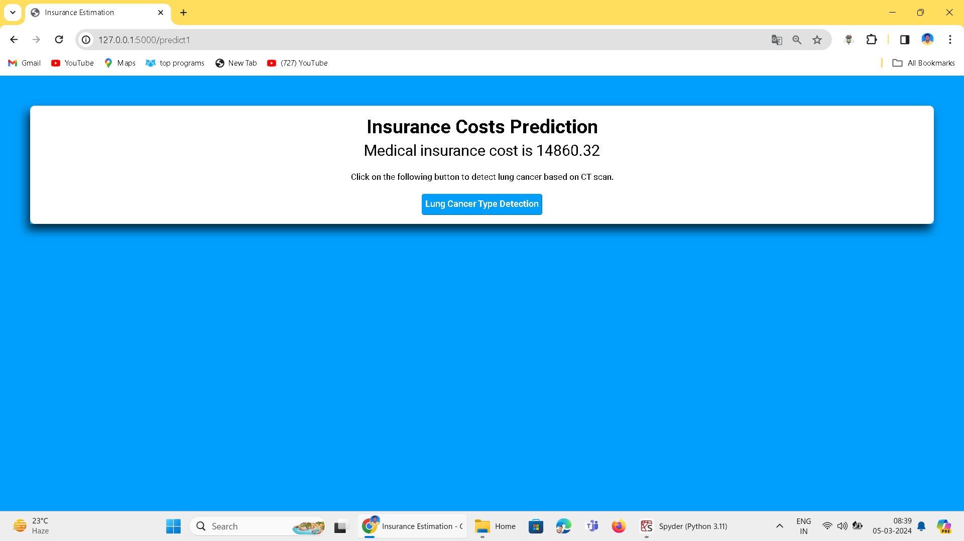
Medical Insurance Output

Slide 34
ADVANTAGES
Comprehensive Solution: Integrates analysis, detection, prediction, staging, and cost estimation for thorough lung cancer assessment.
Early Detection: Utilizes advanced techniques for prompt treatment planning and improved outcomes.
Personalized Treatment: Tailors therapy for optimized effectiveness and patient care.
Financial Planning Aid: Estimates costs for better financial preparedness.
User-Friendly Interface: Enhances engagement and navigation for improved user experience.

Slide 35
CONCLUSION
The goal of this project was to advance the fight against lung cancer by providing a comprehensive solution that integrates diagnosis, prediction, and financial planning. Through the implementation of advanced techniques such as the Random Forest Classifier, CT scan prediction, and nodule staging, we aimed to empower healthcare providers with tools for early detection and accurate prognosis, thereby improving patient outcomes and enabling personalized treatment strategies. Additionally, our system's capability to estimate medical insurance costs aimed to provide essential financial support, easing the burden for patients and ensuring better preparedness for treatment expenses. In essence, the goal of this project was to make a meaningful impact in the lives of those affected by lung cancer, combining innovation with compassion to contribute to the larger goal of eradicating lung cancer.

Slide 36
REFERENCES
Ali, I., Hart, G. R., Gunabushanam, G., Liang, Y., Muhammad, W., Nartowt, B., Kane, M., Ma, X., & Deng, J.: Lung nodule detection via deep reinforcement learning. Frontiers in oncology, 16;8:108, 2018.
Bhatia, S., Sinha, Y., & Goel, L.: Lung cancer detection: a deep learning approach. In Soft Computing for Problem Solving. Springer, Singapore, 699-705 (019).
Choi, W., Oh, J. H., Riyahi, S., Liu, C. J., Jiang, F., Chen, W., ... & Lu, W.: Radiomics analysis of pulmonary nodules in low‐dose CT for early detection of lung cancer. Medical physics, 45(4):1537-49, 2018.

Slide 37
REFERENCES Contd.,
Masud, M., Sikder, N., Nahid, A. A., Bairagi, A. K., & AlZain, M. A.: A machine learning approach to diagnosing lung and colon cancer using a deep learning-based classification framework. Sensors, 21(3):748, 2021.
Muthazhagan, B., Ravi, T., & Rajinigirinath, D.: An enhanced computer-assisted lung cancer detection method using content-based image retrieval and data mining techniques. Journal of Ambient Intelligence and Humanized Computing, 2:1-9, 2020.
Nasrullah, N., Sang, J., Alam, M. S., Mateen, M., Cai, B., & Hu, H.: Automated lung nodule detection and classification using deep learning combined with multiple strategies. Sensors, 19(17):3722, 2019.

Slide 38
REFERENCES Contd.,
Nasser, I. M., & Abu-Naser, S. S.: Lung cancer detection using artificial neural network. International Journal of Engineering and Information Systems (IJEAIS), Mar;3(3):17-23, 2019.
Sajja, T., Devarapalli, R., & Kalluri, H.: Lung Cancer Detection Based on CT Scan Images by Using Deep Transfer Learning. Traitement du Signal, 36(4):339-44, 2019.
Tripathi, P., Tyagi, S., & Nath, M.: A Comparative Analysis of Segmentation Techniques for Lung Cancer Detection. Pattern Recognition and Image Analysis, 29. 167-173, 2019.

Slide 39
THANK YOU

